Slide 1
Central Bedfordshire
Multi-Agency Safeguarding Arrangements
Central Bedfordshire Safeguarding Children Partnership

Slide 2
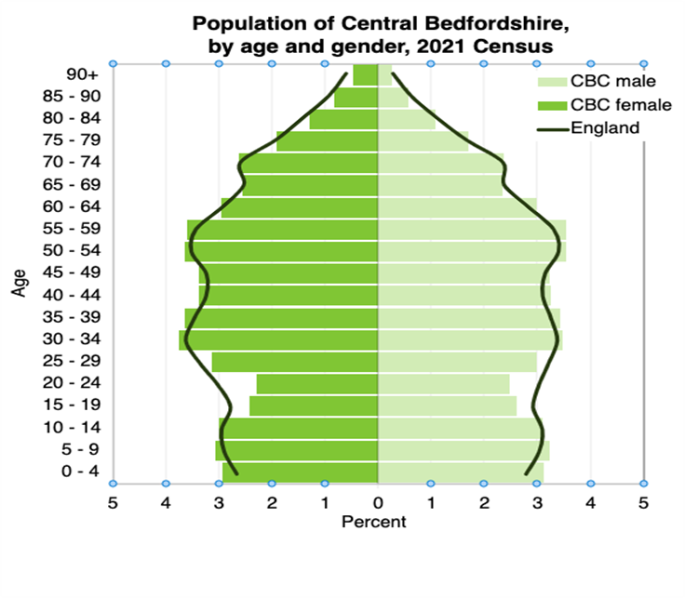
Our Children and Young People
Source: Office for National Statistics, Census 2021

Slide 3
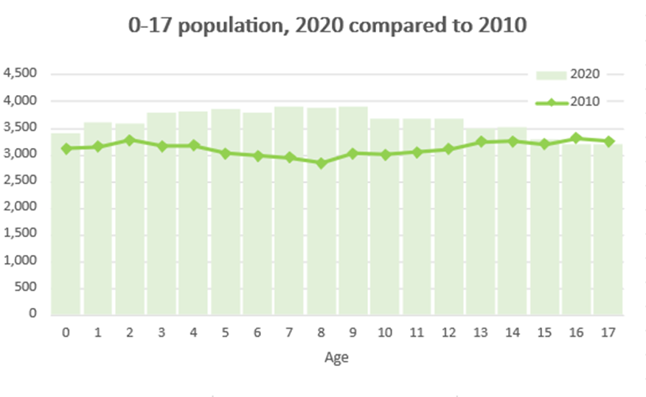
Our Children and Young People
Source: Office for National Statistics, Mid-Year Estimates of population by single year of age, 2010 and 2020

Slide 4
Our Children and Young People
Child Poverty Information:
Percentage of children aged under 16 in Relative in low-income families | 2019/20 | 2020/21
United Kingdom | 19.30% | 18.70%
Central Bedfordshire | 11.40% | 10.80%
Neighbouring Local Authorities
Luton | 30.90% | 27.80%
Milton Keynes | 18.00% | 18.10%
Bedford | 17.10% | 14.90%
Buckinghamshire | 12.00% | 13.00%
Huntingdonshire | 12.40% | 11.20%
Dacorum | 11.30% | 10.20%
North Hertfordshire | 10.60% | 10.00%
South Cambridgeshire | 8.70% | 7.70%
St Albans | 7.50% | 6.90%
Central Bedfordshire highest wards
Eaton Bray | 21.70% | 22.00%
Dunstable Manshead | 16.90% | 16.90%
Dunstable Icknield | 13.20% | 15.50%
Tithe Farm | 19.80% | 15.40%
Houghton Hall | 19.80% | 16.20%
Source: DWP, Children in Low Income Families (Relative) by Local Authority (2020/21)

Slide 5
Our Children and Young People
Education Information:
Education Information
No. pupils in Central Bedfordshire schools | 46896
% of Black, Asian & Minority ethnicity pupils | 14.7% (England 27.4%)
No. of pupils eligible for Free School Meals (FSM) | 5752
No. of pupils receiving Free School Meals (FSM) | 12.3% (England 22.5%)
No. of children with a Special Educational Need (SEN) | 7481
No. of children with Education Health Care Plan (EHCP) | 2034
Source: School Census Data (January 2021)

Slide 6
Our Children and Young People
Participation in Education, Employment of Training:
 | Central Bedfordshire | Regional | National
2021-2022
No. of 16 & 17 year olds engaged in Education, Employment or Training | 95.8% | 95.8% | 95.5%
3-month average (February 2022)
Engaged in Education, Employment or Training (%) | 96.4 | 96.1 | 94.3
Not engaged in Education, Employment or Training (%) | 2.4 | 2.8 | 2.7
Not Known (%) | 1.3 | 1.1 | 2.2
Source: Central Bedfordshire Youth Support Service Annual Report 2021-22

Slide 7
Our Children and Young People
Early Help and Child Protection Information:
Description/Status | Number of cases
Early Help Cases
Children in Need Cases
Children on a Child Protection Plan
Children Looked After
Source: Central Bedfordshire Council Children’s Services Data – March 2023

Slide 8
Children & Social Work Act 2017
Removed requirement for Local Authorities to establish LSCBs
Instead, it places a duty upon 3 local partners - the Local Authority, the Police and the Integrated Care Board to: Work together to safeguard and promote the welfare of children in their area’
A system is in place for local and national case reviews
There is a National Child Safeguarding Practice Review panel in place
The responsibility for the Child Death Overview Panel (CDOP) is the responsibility of Department of Health (taken forward locally by ICB)
There is a flexibility to work with other partners and across boundaries
Central Bedfordshire
Safeguarding Children Partnership

Slide 9
Working Together 2018
Sets out expectations for Local safeguarding Children Partnerships
Roles and responsibilities
Arrangements for Child Safeguarding Practice Reviews
Central Bedfordshire
Safeguarding Children Partnership

Slide 10
Central Bedfordshire Multi-Agency Safeguarding Arrangements
Central Bedfordshire has its own Strategic Safeguarding Children Board which is chaired by an Independent Scrutineer.
It also has its own individual Case Review Group which is also independently chaired.
The Case Review Group is responsible for taking forward local Child Safeguarding Practice Reviews and linking in with the National Safeguarding Practice Review Panel.
There is also a Central Bedfordshire focused Performance Group
Underneath these groups as much work as possible is completed using a Pan Bedfordshire approach, and there is a selection of Pan Bedfordshire Sub-groups.
Central Bedfordshire
Safeguarding Children Partnership

Slide 11
Key Principles
Safeguard the rights of all children consistently across the county but not losing the focus on the needs of Central Bedfordshire children and young people
That all partners keep the child in focus when making decisions about their lives and work in partnership with them and their families.
All partners to champion a continues cycle of learning, to further develop service provision and delivery to support the child and their family.
Duty to co-operate on all partners, particularly schools
Independent challenge, authority and resource to fulfil both statutory functions & ensure learning
That any change is not led by austerity or efficiencies but by measurable improvements in the safeguarding system that benefit children and families
Central Bedfordshire
Safeguarding Children Partnership

Slide 12
Governance and Reporting
Governance:
The Governance for the multi-agency safeguarding arrangements sits with the 3 Multi-agency Safeguarding Partners and sits within their internal governance structures:
  Local Authority – Executive Committee
  Bedfordshire, Luton and Milton Keynes Integrated Care Board (BLMK) – ICB Governing Board
  Bedfordshire Police – The PEEL Board
Reporting:
In order to bring about transparency the Central Bedfordshire Multi-Agency Safeguarding Arrangements publishes a report at least every 12 months which sets out what has been done as a result of the arrangements and will include information on child safeguarding practice reviews.
Central Bedfordshire
Safeguarding Children Partnership

Slide 13
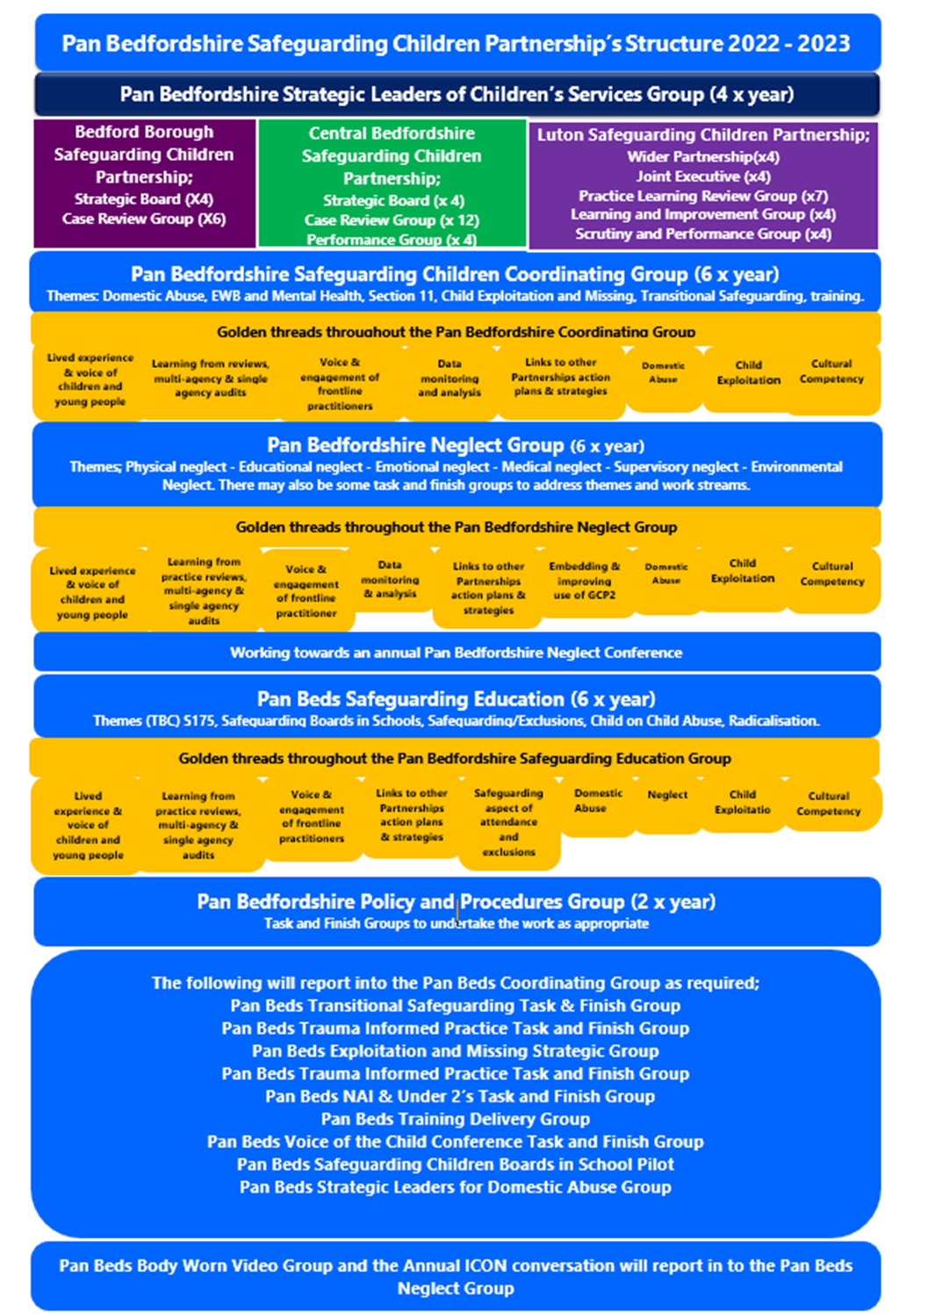
Structure Chart
Central Bedfordshire
Safeguarding Children Partnership

Slide 14
Independent Scrutiny
The Central Bedfordshire Multi-agency Safeguarding Arrangements are chaired and scrutinised by an independent appointment.
The Chief Executive of the Local Authority, drawing on the other multi-agency partners holds the chair to account for the effective working of the Multi-Agency Safeguarding Arrangements.
The Independent Chair/Scrutineer is responsible for scrutinising and challenging local partners and considering how effectively the safeguarding arrangements are working for children, families and practitioners and how well are the safeguarding partners providing strong leadership.
The Strategic Safeguarding Board also has 1 lay member.
Central Bedfordshire
Safeguarding Children Partnership

Slide 15
Multi-Agency Partners
The multi-agency partners who are part of the arrangements are listed in full within the MASA Documents, but examples are:
Local Authority, the Police, Health Commissioners and Providers, CAFCASS, Probation Services, Youth Offending Service, Education representatives, Lay Members and representatives from the Voluntary sector.
Central Bedfordshire
Safeguarding Children Partnership

Slide 16
Links to Education Settings
On the Central Bedfordshire Strategic Board there are representatives from the Local Authority School Improvement Team along with senior representatives from a local secondary school, primary school and college. Officers from the Local Authority School Improvement Team also sit on the Central Bedfordshire Case Review Group and Performance Groups.
In addition, there is a Pan Bedfordshire Safeguarding in Education Sub-group that is chaired by the 3 Bedfordshire Local Authority Chief Officers for Education (on a rotating basis) and has representatives from schools across Bedfordshire.
There is a dedicated section of the regular Schools Designated Leads (DSL) Forum, where schools can raise issues or information that they would like feedback to the Safeguarding in Education Group.
Central Bedfordshire
Safeguarding Children Partnership

Slide 17
Links to Education Settings
The Business Manager of the Safeguarding Children’s Partnership attends the DSL forum on a regular basis to provide updates on behalf of the partnership, and Local schools and colleges are invited to take part in audits and case reviews where they are relevant.
The Safeguarding Children Board also communicates with schools via its own newsletter, there is also a local newsletter dedicated for schools.
Central Bedfordshire
Safeguarding Children Partnership

Slide 18
Learning and Improvement
Framework
PRACTICE
(Sources of learning)
REVIEWS OF PRACTICE
Case reviews
Child death reviews
Planned audits
Data Analysis
National
learning
IDENTIFICATION OF LEARNING
Dissemination of learning
Actions for improvement
PRACTICE
(Embedding learning)
Central Bedfordshire
Safeguarding Children
Partnership

Slide 19
Funding
The Multi-agency Safeguarding Arrangements are funded by the multi-agency safeguarding partners on an annual basis – details can be found within the MASA Documents.
Central Bedfordshire
Safeguarding Children Partnership

Slide 20
Links to other Partnerships
To be effective the Central Bedfordshire Multi-Agency Safeguarding arrangements for children link into other local partnerships and boards such as:
The Central Bedfordshire Health and Wellbeing Board
The Central Bedfordshire and Bedford Borough Safeguarding Adult Board
Bedfordshire Channel Panel
Central Bedfordshire Community Safety Partnership
Bedfordshire Local Family Justice Board
Bedfordshire MAPPA Panels
Bedfordshire Youth Justice Board
Any local improvement boards
Within Central Bedfordshire there is a joint protocol in place whereby the chairs from Safeguarding Children’s Board, Safeguarding Adults Board, Health and Wellbeing Board, Community Safety Partnership, Children’s Leadership Board and the Youth Justice Board meet on a regular basis to discuss cross cutting themes/issues and priorities.
Central Bedfordshire
Safeguarding Children Partnership

